Slide 1

Targeted speech enhancement with voice fingerprint
Khandokar mD. Nayem
Summer intern 2020

Slide 2
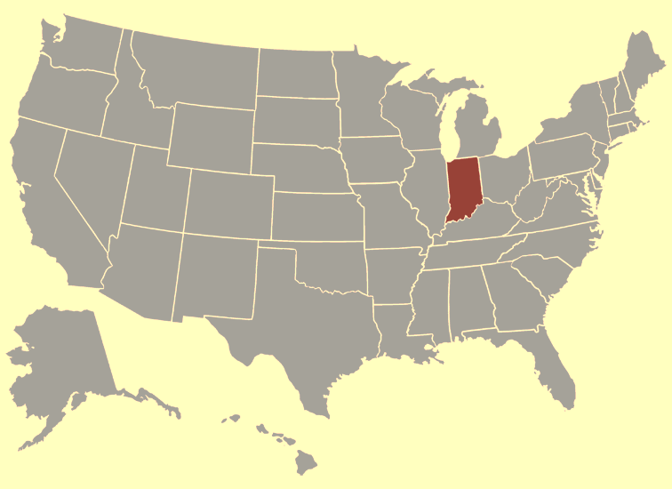


About me
4th year Ph.D. student at Indiana University, Bloomington, IN.
Major in computer science and minor in cognitive science.
Summer intern in ARCD (12 weeks).
Worked on project Anna’s Taqueria.

Slide 3
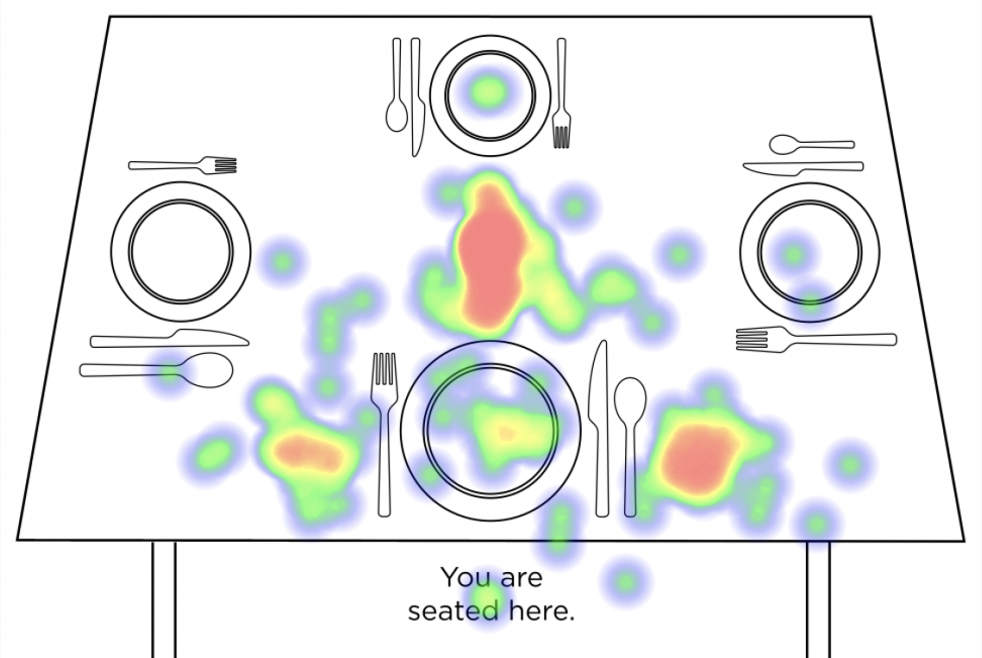
Background
Remote microphone is an idea to capture the audio through a remote microphone (for example a phone’s), process the audio and feed enhanced speech to the HA.
Adds benefit of microphone being closer to speaker and gives us additional compute to run speech enhancement.
Issue: Latency. Bluetooth connection introduces too much latency. Humans are much more sensitive to latency on their own voice than to others.
Idea: Use machine learning to remove self-speech and noise, in order to provide SNR benefits while avoiding latency sensitivity.

Slide 4






Overview
Playing tennis would be fun.
Wanna watch a movie?
Multiple speakers' speech in noisy environment is the input.
Voice fingerprint is a key unique of each speaker.
Using the voice fingerprint, we separate the speaker speech.
Voice fingerprint of each speaker is collected beforehand in a quiet setting. For example, during device unboxing and enrollment.
Voice fingerprint
Voice fingerprint
Playing tennis would be fun.
+
=
Wanna watch a movie?
Wanna watch a movie?
Playing tennis would be fun.
+
=
Playing tennis would be fun.
Wanna watch a movie?
mix | separated
1 | 2

Slide 5
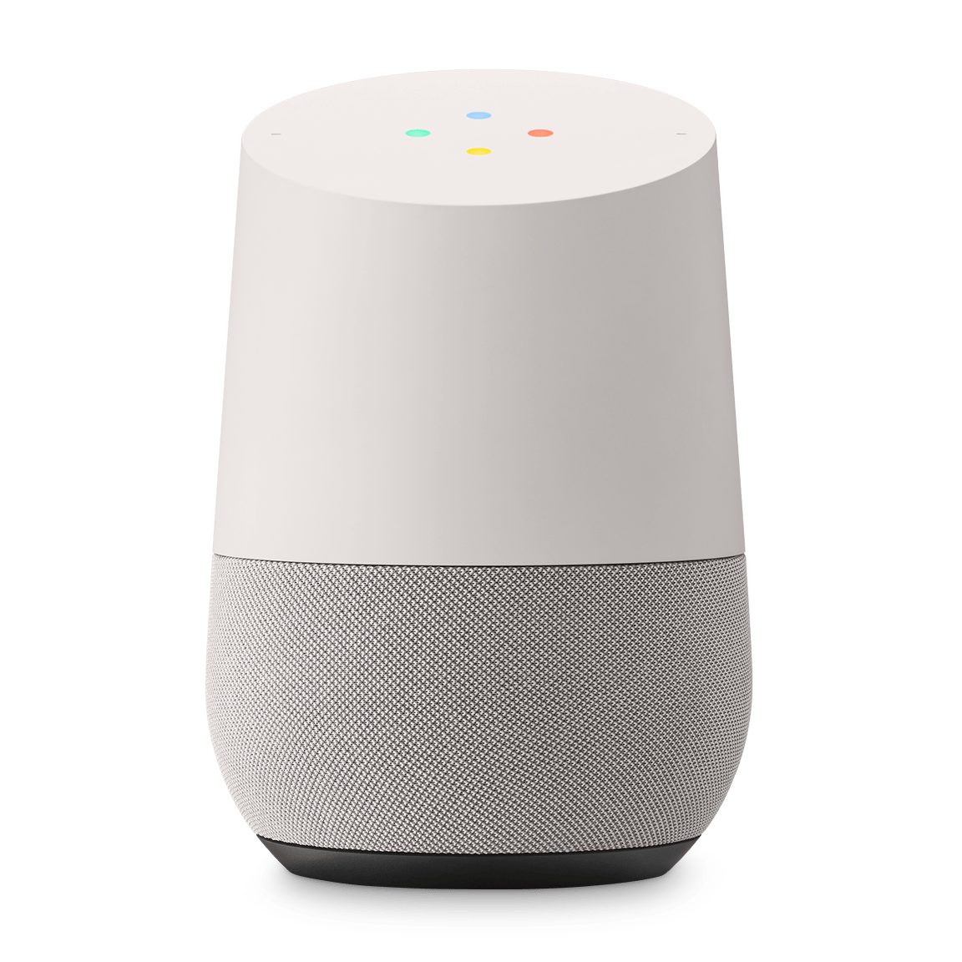
Inspiration: VoiceFilter
Playing tennis would be fun.
Wanna watch a movie?
Targeted speech separation (SS).
Targeted voice separation (speaker A vs. speaker B) using voice fingerprint.
Designed for use in disambiguating speakers in Google Home.
Wang, Quan, et al. "Voicefilter: Targeted voice separation by speaker-conditioned spectrogram masking." arXiv preprint arXiv:1810.04826 (2018).
VoiceFilter
Voice fingerprint
Wanna watch a movie?
Notes:
“Yu-Ding focused on voice fingerprint, my task was entire system,”

Slide 6
Inspiration: VoiceFilter
Targeted speech separation (SS).
Targeted voice separation (speaker A vs. speaker B) using voice fingerprint.
Designed for use in disambiguating speakers in Google Home.
Wang, Quan, et al. "Voicefilter: Targeted voice separation by speaker-conditioned spectrogram masking." arXiv preprint arXiv:1810.04826 (2018).
Notes:
“Yu-Ding focused on voice fingerprint, my task was entire system,”

Slide 7
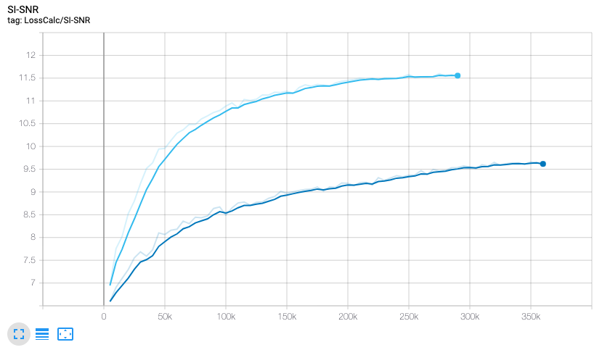
Reimplementing VoiceFilter with utterance level D-vec
Utterance level D-vec is extracted from the clean targeted speech.
Task is only source separation (SS); no additional noise is added.
Utterance level D-vec gives around +2dB gain.
Practically speaking, extracting utterance level D-vec prior speaker speaks is not possible!
 | SS
 | SS w/ uttr-Dvec
mix | SS w/ dvec
4 | 6

Slide 8
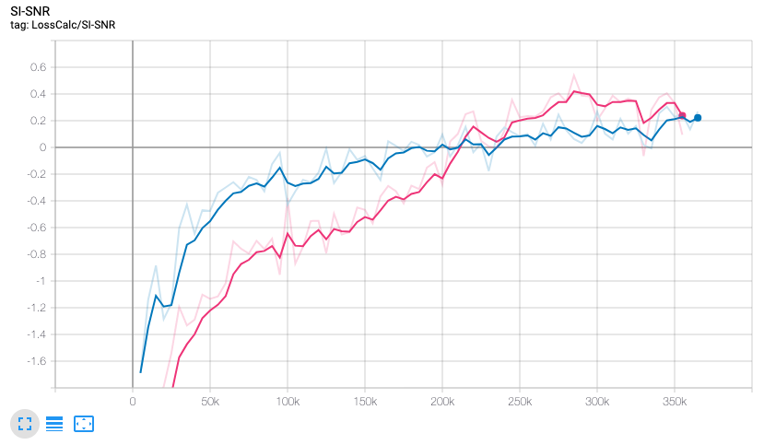
Can Arby’s benefit from voice fingerprints?
Speech enhancement using D-vec
 | SE
 | SE w/ uttr-Dvec

Slide 9

Anna’s Taqueria: Initial Approach
Playing tennis would be fun.
Wanna watch a movie?
Goal: combine targeted speech separation (SS) with speech enhancement (SE) to selectively remove or enhance a speaker from a noisy mixture.
Idea is to denoise mixture of speakers, then pass denoised mixed speech to source separation.
This turns out not to work so well.
Possibly due to the fact that Voicefilter is not equipped to deal with signal coloration from Arby’s.
Also VoiceFilter model was trained on a smaller dataset at this point.
Playing tennis would be fun.
Wanna watch a movie?
VoiceFilter
Voice fingerprint
Wanna watch a movie?
mix | arby’s | voiceFilter

Slide 10
New approach: Combine VoiceFilter and Arby’s
Playing tennis would be fun.
Wanna watch a movie?
End to end network that both denoises and separates speech.
Motivation is to get the best of both SE and SS models while exposing source separation network to speech enhancement distortions.
Voice fingerprint
( )
+
VoiceFilter
Wanna watch a movie?

Slide 11
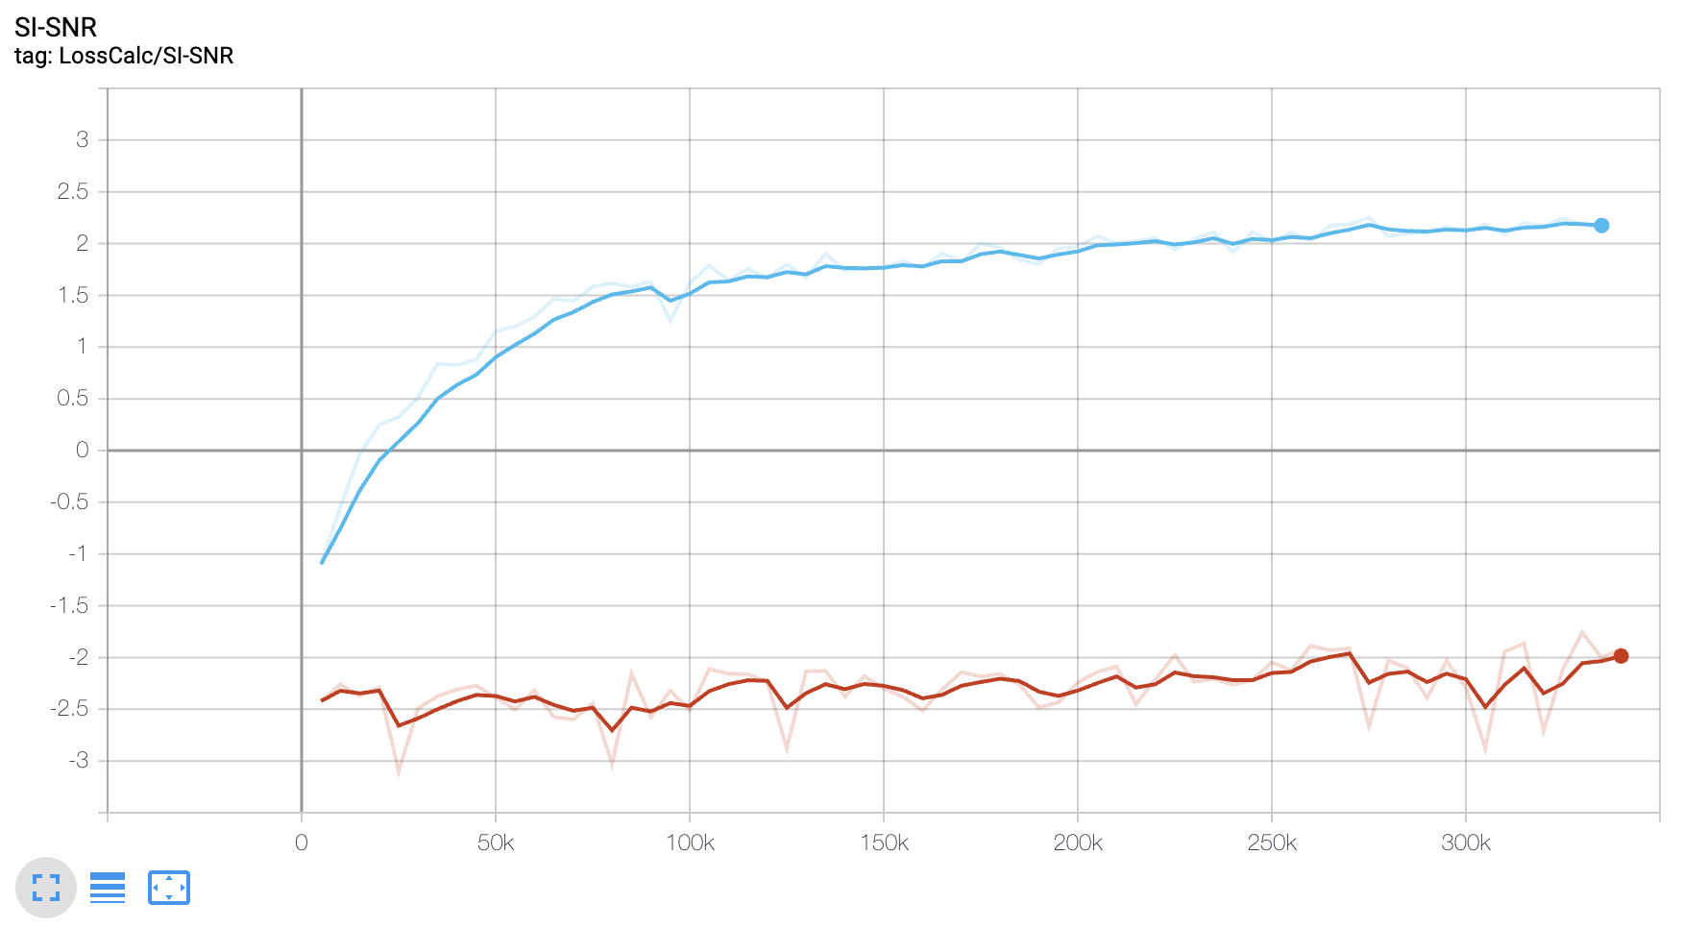
New approach: Combine VoiceFilter and Arby’s
End to end network that both denoises (SE) and separates speech (SS).
Motivation is to get the best of both SE and SS models while exposing source separation network to speech enhancement distortions.
Does significantly better than piecewise approach.
 | anna’s
 | anna’s w/ uttr-Dvec

Slide 12
End-to-end SS+SE w/ global D-vec
Global D-vec is the mean D-vec of all the utterance level D-vec of the target speaker.
Up till now, we have been using d-vectors from the actual utterances we're denoising. This isn't possible in practice.
Our first cut at using a held-out d-vector was to use a "global" d-vector, which is simply the mean of all of that user's d-vectors.
 | anna’s
 | anna’s w/ global-Dvec

Slide 13
Realistic Voice Fingerprint Training
Pseudo global (Leave one out)
Compute the mean of all the utterance level D-vec except the current utterance D-vec for the target speaker.
Random other
Randomly choose an utterance D-vec of the target speaker from other frame.
GMM
Train a GMM on each speaker’s voice fingerprint distribution and sample a voice fingerprint from the GMM as the target speaker’s fingerprint.
Pseudo global, random other, GMM

Slide 14
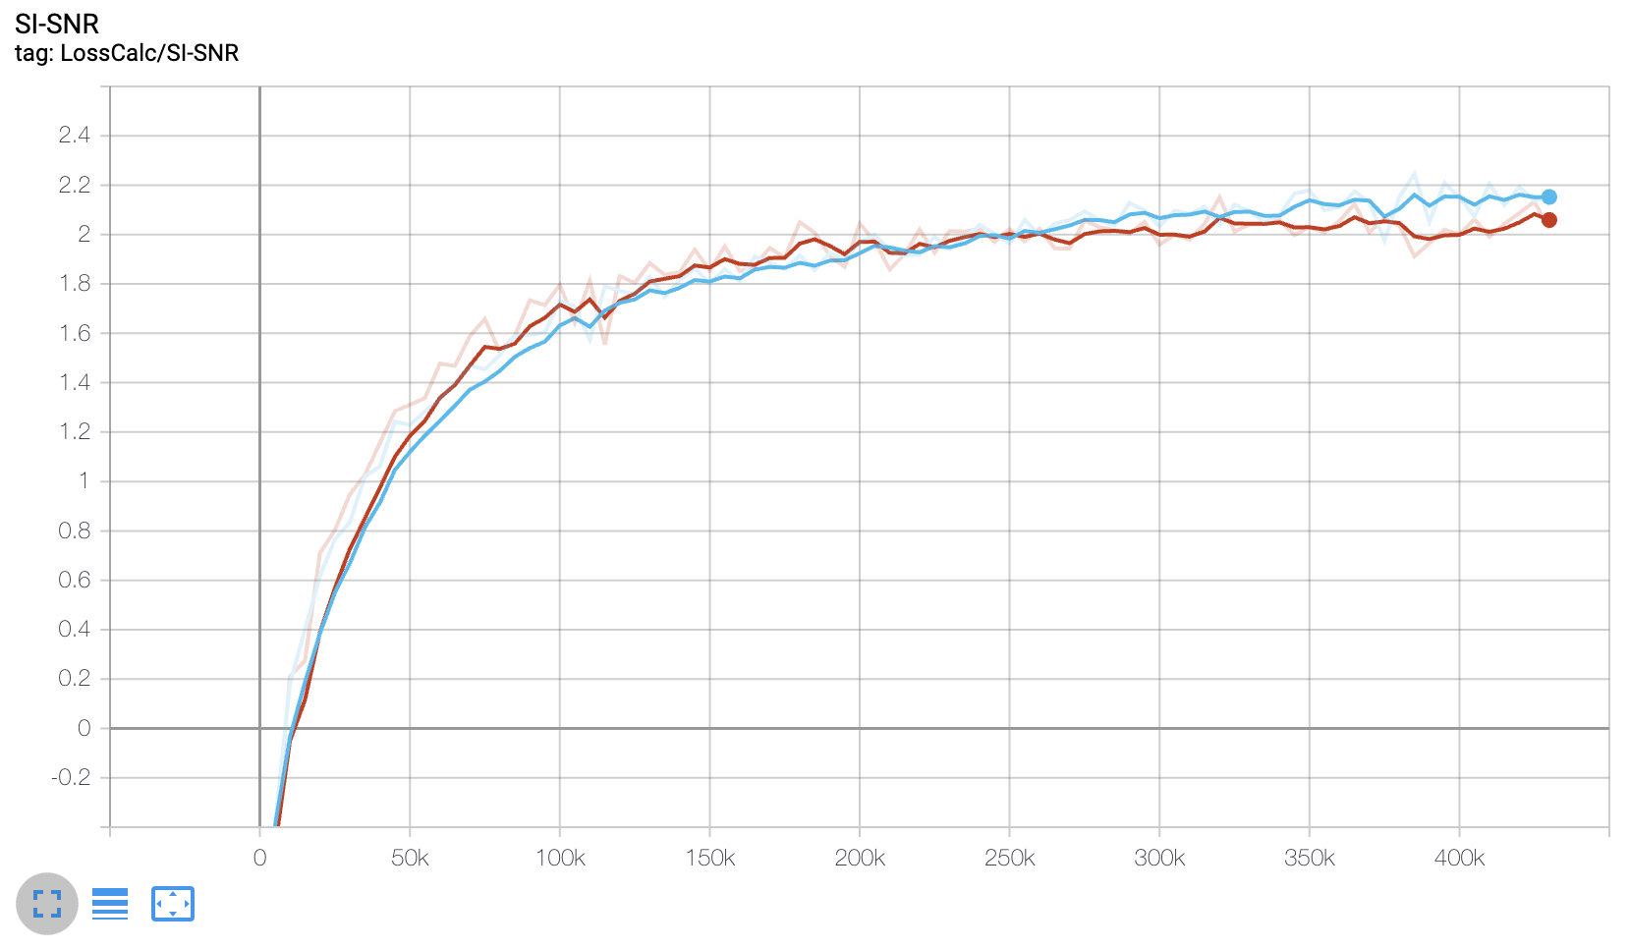
Results pseudo global, Random other
 | Pseudo
 | Random

Slide 15
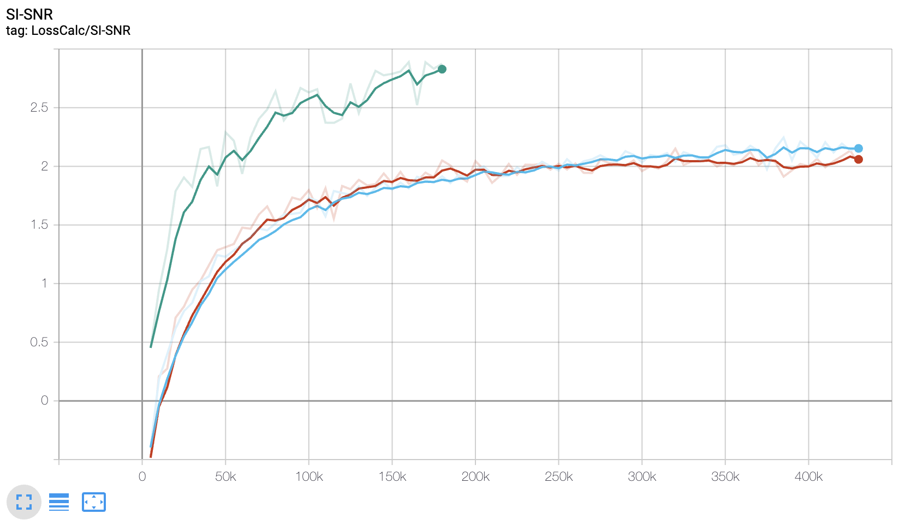
Results Random other in different sized dataset
 | Ar+Ch pseudo
 | Ar+Ch random
 | Ar+Ch+LibiSpch random other
mix | Arby’s, Chime2, LibiSpeech (rand) | Arby’s, Chime2 |  | clean
 |  | pseudo | random
24 | 25 | 26 | 27 | 28

Slide 16
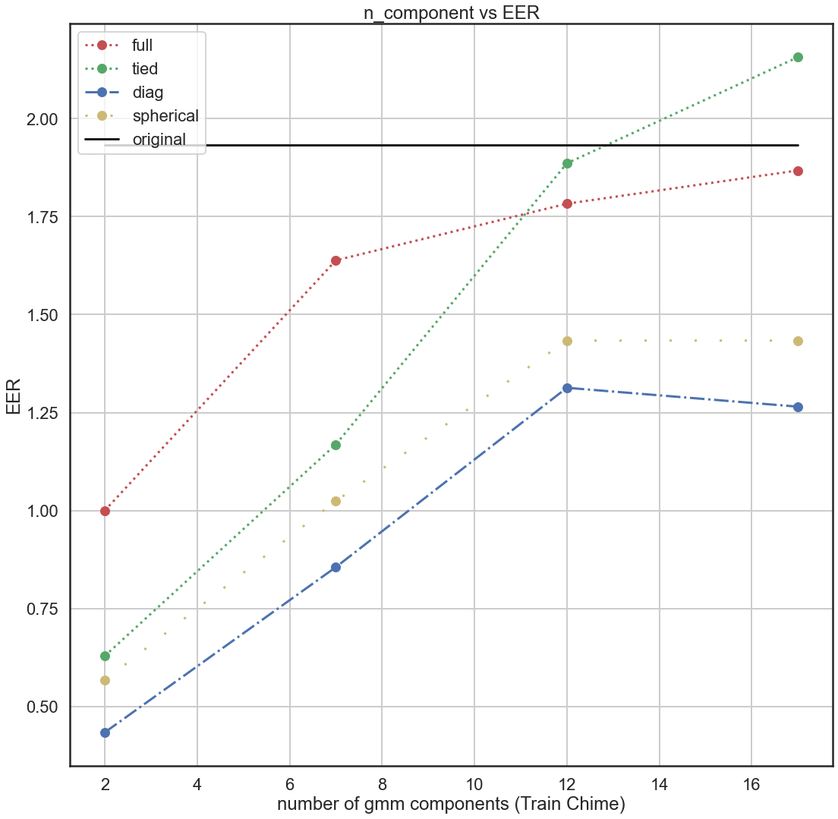
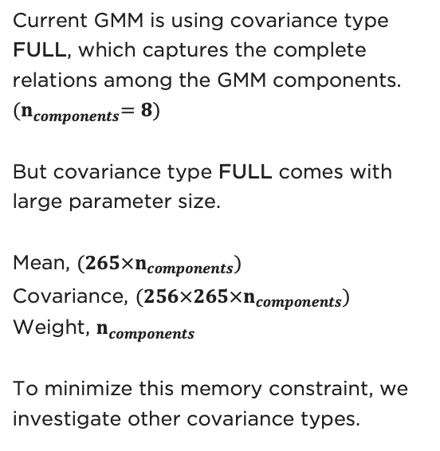
Different GMM methods
Current GMM is using covariance type FULL, which captures the complete relations among the GMM components. ${(n}_{components}=8)$
But covariance type FULL comes with large parameter size.
Mean, ${(265×n}_{components})$
Covariance, ${(256×265×n}_{components})$
Weight, $n_{components}$
To minimize this memory constraint, we investigate other covariance types.

Slide 17
Future work
VoxCeleb1 and VoxCeleb2 dataset are not incorporated into the large dataset.
GMM sample should be included into the input pipeline for faster step/sec.
Different covariance types GMM should be compared.
Move from targeted speaker separation to self-speech removal.
With a segmented network, this is trivial to implement by flipping the source separation mask .
When the network is trained to both denoise and separate speech end to end, it must be trained to remove the specific speaker.
Introduce auxiliary losses to encourage the different parts of the model to learn specialize to the speech enhancement and source separation tasks.

Slide 18
Thank you
Team Anna’s
Marko Stamenovic
Richard Yang
Carl Jensen
Alex Pawlicki
Yu-Ding Lu
Khandokar Md. Nayem

Slide 19


